Slide 1


Southwest University of Science and Technology
Thesis Defense
Title: Machine Learning Based Fake News Detection
Present by
MD MAHMUDUL HASAN TAREQ
Student ID: 4420190083
School of Computer Science and Technology
Supervisor: Prof. Dr. Yin Long

Slide 2

01
Introduction
02
Objective
Overview of the Presentation
03
Methodology
04
Results and Discussion
05
.Conclusion

Slide 3
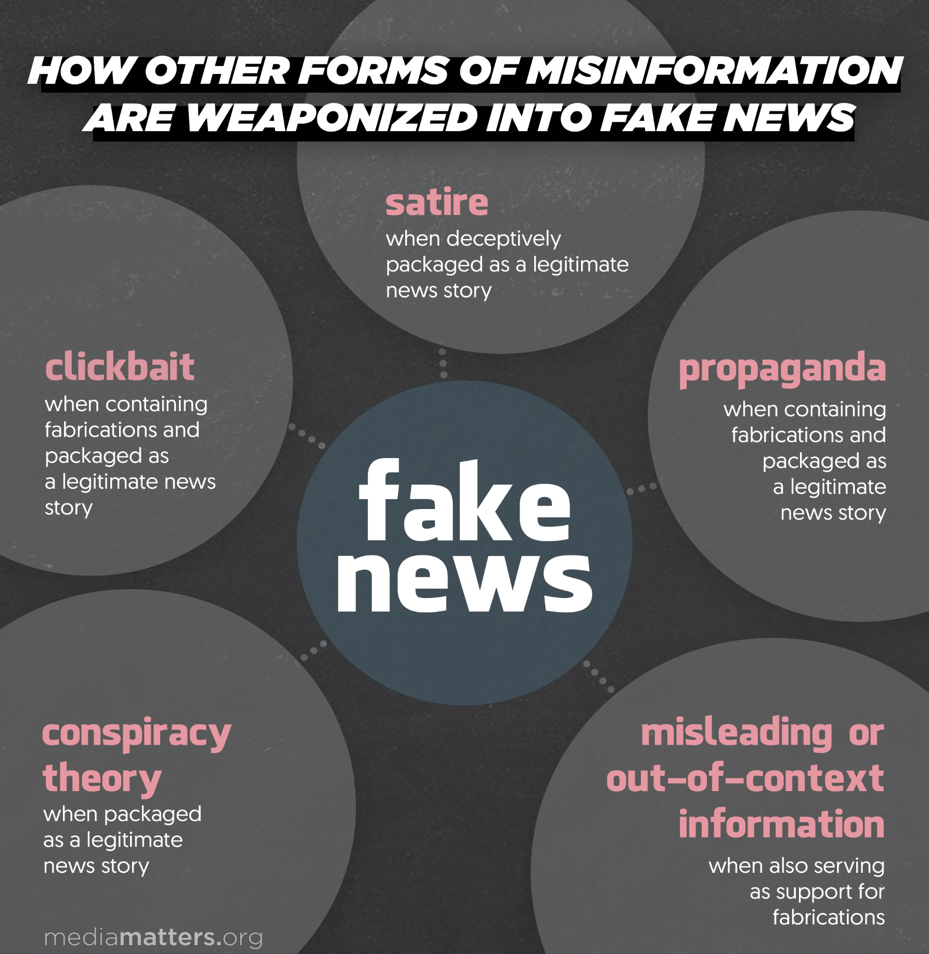
Introduction
Fake news is a type of news or stories which is deliberately made to propagate someone’s opinion, spread misinformation or established a doctrine.
Mainly fake news spread through social media like Facebook, Twitter, Weibo, QQ etc.
The spread of fake news is not a new phenomenon but The term "fake news" gained widespread attention during the 2016 U.S. presidential election, when it was widely claimed that fake news was used to sway public opinion.
there are many forms of fake news we can see in the picture.

Slide 4

In today’s digital age most of us consume news from social media where anyone can share news without any limitation.
Fake news can have a significant impact on society, including spreading false information about political candidates, causing panic during a crisis, and undermining public trust.
In extreme cases, fake news can even lead to violence and other harmful actions.
Fake news often has the aim of damaging the reputation of a person or entity, or making money through advertising revenue.
During covid-19 situation we suffer a lot because of fake news related to vaccine, mask, sanitization etc.
The rise of fake news has become a global problem that even major tech companies are struggling to solve it. It can be difficult to determine whether a text is factual without additional context and human judgement.
Problem

Slide 5
The Second Objective
Objectives
The system should be able to analyze text data and other relevant features, such as source credibility and social engagement, to differentiate between real and fake news articles or posts.
The First Objective
The Third Objective
The first research objective of this study is to develop an effective and accurate system that can automatically identify and flag fake news articles or posts.
The third and main objective of this study is to develop and evaluate a machine learning model with an accuracy rate of at least 90%, and a false positive rate of less than 5%.

Slide 6
04
Literature Review
The authors (Srivastava et al., 2014) tested their approach on a range of internet sites using rules for content veracity analysis. In one of their tests, they achieved an overall accuracy of 88.00% by using a practical fake news dataset (FakeNewsNet). The authors of one study (Ahmed et al., 2017) employed several machine-learning techniques to identify bogus news and used TF-IDF vectorization as a feature extractor. In their study, the authors (Yang et al., 2018) used CNN (Convolutional Neural Network) to detect fake news. They applied sensitivity analysis in their technique and achieved an accuracy rate of 92.10%. (Zhou et al., 2019) developed a theory-driven approach to detect fake news by extracting misinformation and clickbait elements from news article text and employing machine learning models such as SVM, Random Forest, XGBoost, Naive Bayes, and Logistic Regression. Author (Aggarwal et al., 2020) present a paper where they achieved an accuracy of 97.02% by using a fine-tuned BERT model for fake news classification. Several research investigate the significance of deep learning models over machine learning models for detecting fake news (Choudhary et al., 2021; Mouratidis et al., 2021). The self-attentive system came in first place in the Clickbait Challenge. For false news classification, hybrid deep learning models that blend convolutional and recurrent neural networks fared slightly better than non-hybrid baseline methods (Nasir et al., 2021).

Slide 7
Methodology
Data Collection
Compare Results
Here is my research work methodology:
At first I collect Dataset from Kaggle. Then pre-process this text data through wordopt function and extract feature by TF-IDF vectorization.
Then I train my model with 5 different machine learning algorithm. Finally I evaluate these model and compare their results.
Let’s talk a little bit about this method in the following slides.
Data Pre-processing
Model Evaluation
Feature Extraction
Model Training

Slide 8
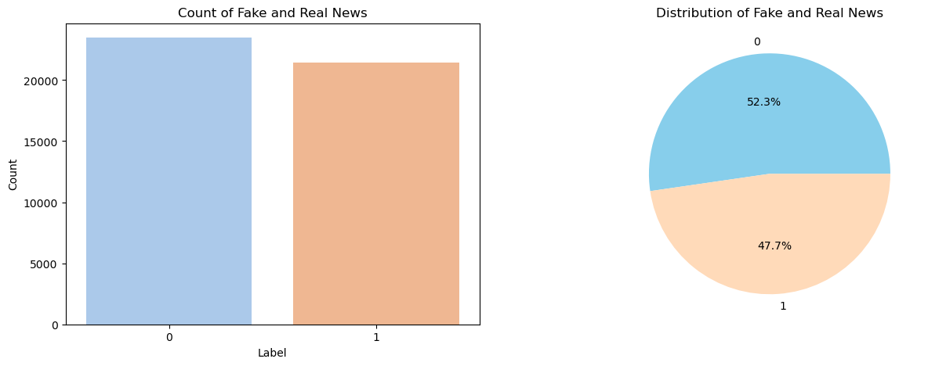
Dataset
I have collected dataset from Kaggle which is a open source platform. The name of this dataset is Fake and Real news dataset which was share by Clément Bisaillon.
The dataset consist of two csv file one is “Fake.csv” and another one is “True.csv”. This dataset has four column title, text, subject, date.
In total this dataset contain more than 44,000 news article’s where fake news is 23,481 and the real news is 21,417. From this graph we can see that the fake news is 52.3% and real news is 47.7%.

Slide 9

Data Cleaning
Data
Pre-processing
My collected data was clean before so I didn’t need to clean data.
Data transformation
I used the wordopt function to process the text data according to the following steps:
The news article's characters are all transformed into lowercase letters.
I removed all punctuation and accent marks.
All numerical values have been removed
All the blank spaces have been eliminated.
Words that are repeated are expelled.
Data Integration
In this process I label my dataset because my dataset wasn’t labeled before. “Fake.csv” which I label as “0” and “real.csv” which I label as “1”. And then I merge this two datasets in one data frame with the help of the Panda library. After that I removed columns that are not required like title, subject, and date.

Slide 10
Feature Extraction
To effectively analyze text-based data, it is Important to convert the textual data into numerical representations. TF-IDF vectorization is an extensively used technique in natural language processing.
TF-IDF is a numerical score that reflects the importance of a word in a document.
It is calculated by multiplying two values: the Term Frequency (TF) and the Inverse Document Frequency (IDF). Here is the equation
TF-IDF = TF * IDF
Term Frequency (TF)
The number of times a word appears in a document.
Higher values indicate that the word is more important to the document.
TF is calculated as the number of word (x) appears in a document /the total number of word in a document.
Inverse Document Frequency (IDF)
A measure of how much information a word provides.
Words that are common across many documents (e.g. "the", "a") have a low IDF value, while words that are rare have a high IDF value.
IDF is calculated as log(N/n), where N is the total number of documents and n is the number of documents that contain the word.

Slide 11
Decision Tree Classifier
Model Training
Logistic Regression
Passive Aggressive Classifier
For model training I used 5 different Machine Learning Algorithm.
I used 80% data for model training and 20% data for model testing.
I used train test split function for splitting data into training set and testing set.
Finally I compare their result based on different metrics like accuracy, precession, recall, F1-score.
Machine Leaning Model
Gradient Boosting Classifier
Random Forest Classifier

Slide 12

Experimental Requirements
Panda
Numpy
Seaborn
Jupyter Notebook
Required Python Libraries
Python
String
RE
Matplotlib
SciKit-Learn

Slide 13
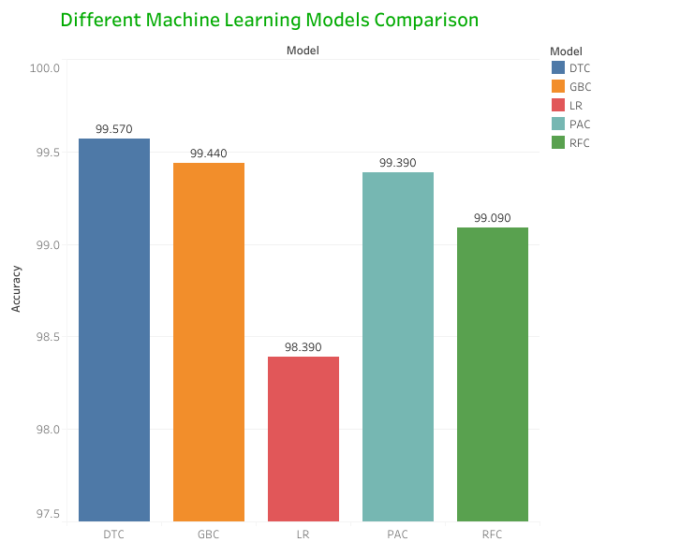
Results
Decision tree classifier achieved the highest accuracy 99.57%
Here we can see that all the model performs very well. Every model has a very good accuracy Score. But the decision tree classifier has the highest accuracy.
For further understanding of these model performance let’s discuss other evaluation matrix in the next slide.

Slide 14
Discussion
Here we can see for Decision tree classifier model the accuracy score is 99.57%. Precision, recall and F1-score are 1.00 which means this model can detect almost every fake news.
Logistic Regression has accuracy 98.39% and precision is 0.99. Recall and F1-score are 0.98. we can say this model is also pretty good but not good than DTC.
Passive Aggressive Classifier has accuracy 99.39%. Where precision is 1.00 and recall and F1-score are 0.99. Gradient boosting Classifier has the same precision ,recall and F1-score value but the accuracy is higher than PAC.
Random Forest Classifier has 99.09% accuracy. Precision, recall and F1-score are 0.99 that means this model is also can detect fake news a big amount.
Model | Accuracy | Precision | Recall | F1-score
DTC | 99.57% | 1.00 | 1.00 | 1.00
LR | 98.39% | 0.99 | 0.98 | 0.98
PAC | 99.39% | 1.00 | 0.99 | 0.99
GBC | 99.44% | 1.00 | 0.99 | 0.99
RFC | 99.09% | 0.99 | 0.99 | 0.99

Slide 15
Error
Analysis
Model | True Negative | False Positive | False Negative | True Positive
DTC | 4723 | 16 | 23 | 4218
LR | 4652 | 87 | 58 | 4183
PAC | 4706 | 33 | 22 | 4219
GBC | 4703 | 36 | 14 | 4227
RFC | 4682 | 57 | 25 | 4216
From this confusion matrix table we can see that Decision tree classifier accurately detect 4723 fake news and make mistake for 16 cases. For real news it can detect accurately 4218 cases and make mistake in 23 cases. Where Gradient Boosting classifier misclassified 14 real news which is less than DTC, but it’s false positive value is higher than DTC which is 36 . Logistic regression false positive and false negative value is higher then any other model which is this model is weak than other model.
Passive Aggressive Classifier false positive value is 33, it means it misclassified 36 fake news cases where random Forest Classifier make mistake for 57 which is higher than DTC, PAC, and GBC. But for real news PAC make mistake 22 which is less than RFC and DTC.
Overall we can say that Decision tree classifier is the best model though it make mistake for some fake and real news which is very less.

Slide 16

Conclusion and Future work
In conclusion this research demonstrates the utility of machine learning algorithm for detecting fake news.
I used five different supervised Machine Learning algorithm for this study and found that Decision Tree Classifier is the best algorithm among them with 99.57% accuracy.
For future work maybe we can propose a deep learning model or a hybrid model with a large dataset. Also, we can use a video or image dataset for detecting fake news as we all know these medium also used for spreading fake news.
Overall, this thesis contributes to the development of more accurate and reliable methods for detecting fake news

Slide 17
Reference
Many Americans Believe Fake News Is Sowing Confusion. [online] Available: https://www.pewresearch.org/journalism/2016/12/15/many-americans-believe-fake-news-is-sowing-confusion/
Srivastava, N., Hinton, G., Krizhevsky, A., Sutskever, I., & Salakhutdinov, R. (2014). Dropout: a simple way to prevent neural networks from overfitting. The journal of machine learning research, 15(1), 1929-1958.
Ahmed, H., Traore, I., & Saad, S. (2017, October). Detection of online fake news using n-gram analysis and machine learning techniques. In International conference on intelligent, secure, and dependable systems in distributed and cloud environments (pp. 127-138).
Zhou, X., Jain, A., Phoha, V. V., & Zafarani, R. (2019). Fake news early detection: an interdisciplinary study. arXiv preprint arXiv:1904.11679.
Choudhary, A., & Arora, A. (2021). Linguistic feature based learning model for fake news detection and classification. Expert Systems with Applications, 169, 114171.

Slide 18
Thanks To Everyone
Specially thanks to my professor Dr. Yin Long

